Slide 1
TRAUMA INFORMED SCHOOLS: A JOURNEY
Joe Fantigrossi, Ed.D., Pre K-12 Intervention Coordinator, Lyons CSD
Jay Roscup, Consortium Grants Administrator, Lyons CSD
Notes:
JOE

Slide 2
Today’s Purpose
Understand the impact
Trauma awareness with current systems
Resources and practices
Action step
(Small is the new Big)
Notes:
JOE

Slide 3
Takeaways
1. Resources
2. Strategies
3. Methods of support
http://bit.ly/2tsiZdL

Slide 4
TRAUMA IS NOT THE EVENT.
TRAUMA IS THE RESPONSE.
EACH INDIVIDUAL RESPONSE TO CHRONIC OR ACUTE STRESS DETERMINES THE LEVEL OF TRAUMATIC IMPACT.
STOP ASKING: What is wrong with this student?
AND START ASKING: What has happened to this student?
Notes:
JOE

Slide 5
ACES-Adverse Childhood Experiences

Slide 6
Why is this important?
Notes:
JAY

Slide 7
ADVERSE CHILDHOOD EXPERIENCES:
ABUSE
NEGLECT
DYSFUNCTION (Family)
Notes:
JAY Adverse Childhood Experiences (ACEs) - potentially traumatic events with negative, lasting effects on health and well-being

Slide 8
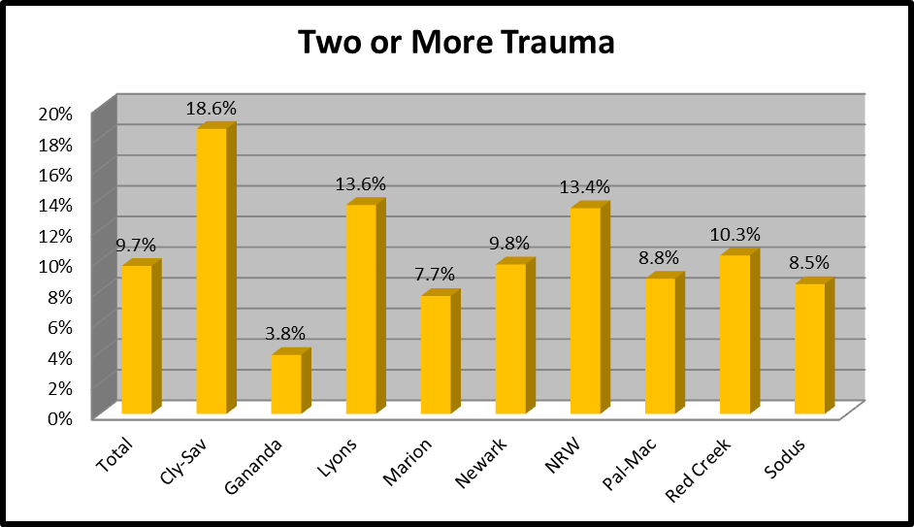
ACE’S REPORTED BY KINDERGARTEN Parents AT SCREENING:
WAYNE COUNTY SCHOOL DISTRICTS
K READY SURVEY- Wayne County 2016
554 out of 1007 Kindergarten Students
10% Wayne Co. Avg
Notes:
JAY

Slide 9
LOCAL K SCREEN: Children with 2 or more “ACE” *:
3 times more likely to not calm down when upset.
Twice as likely to rarely play with children outside the family.
Twice as likely to not be able to independently button or zipper clothing.
13 times less likely to be able to focus on activity other than TV or computer.
* AS REPORTED BY REGISTRANT
Notes:
JAY

Slide 10
LOCAL K SCREEN: Children with 2 or more “ACE” *:
7 times more likely to have moved four or more times.
More than twice as likely to spend less than 3 hours a week in family activity.
2.5 times less likely to have a set bedtime.
5.7 times more likely to ignore rules at home.
4.3 times more likely to never read with parent/adult.
* AS REPORTED BY REGISTRANT
Notes:
JAY

Slide 11
POVERTY Aside
You can be poor and feel:
-Safe
-Loved
-Proud
Notes:
Joe-When a young person or a family is enduring the chronic stress of poverty and is further strained by the acute stress of trauma, the energy required to live positively and build resiliently is significantly greater.

Slide 12
Childhood Trauma
Evalumetrics Youth Survey - 2017 | 2017 | ACE 2 or less | ACE>2 | Ratio
Used Alcohol in Past 30 Days | 20.6% | 15.3% | 31.5% | 2.1
Smoked Cigarettes in Past 30 Days | 6.6% | 4.1% | 12.4% | 3.0
Smoked Marijuna in Past 30 Days | 15.5% | 10.6% | 26.4% | 2.5
Used Any Other Drug in Past 30 Days | 2.0% | 1.1% | 4.2% | 4.0
Felt Sad/Depressed | 41.2% | 29.0% | 68.1% | 2.3
Self-injury | 17.7% | 13.2% | 42.0% | 3.2
Planned Suicide | 10.4% | 4.7% | 25.3% | 5.3
Notes:
JAY

Slide 13
Small Group Activity
Child Welfare Information Gateway:
Understanding the Effects of Maltreatment on Brain Development
Notes:
JOE

Slide 14
Small Group Activity
Read the excerpt from the article to yourself
2. Pair with 2-3 colleagues to identify the impacts of trauma
MENTAL/ PSYCHOLOGICAL | SOCIAL/ BEHAVIORAL | PHYSICAL/ HEALTH
Notes:
JOE

Slide 15
SUPPORTS FOR STUDENTS
Notes:
JAY

Slide 16
Adapt, not additional
IN SCHOOLS, MUCH OF WHAT IS ALREADY DONE CAN BE Integrated INTO A TRAUMA INFORMED APPROACH!!
DON’T THINK “MORE”– THINK “ADAPT CURRENT PRACTICE”
Notes:
JAY

Slide 17
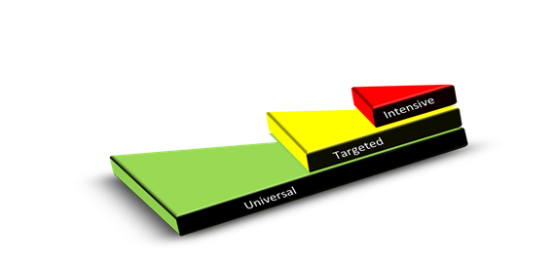
Tiered Intervention
Notes:
JAY

Slide 18
WE BEGAN TO UNDERSTAND TO BE “CULTURALLY EQUITABLE, VALID, KNOWLEDGEABLE & RELEVANT” MEANT WE HAD TO BE TRAUMA INFORMED……
Notes:
JAY

Slide 19
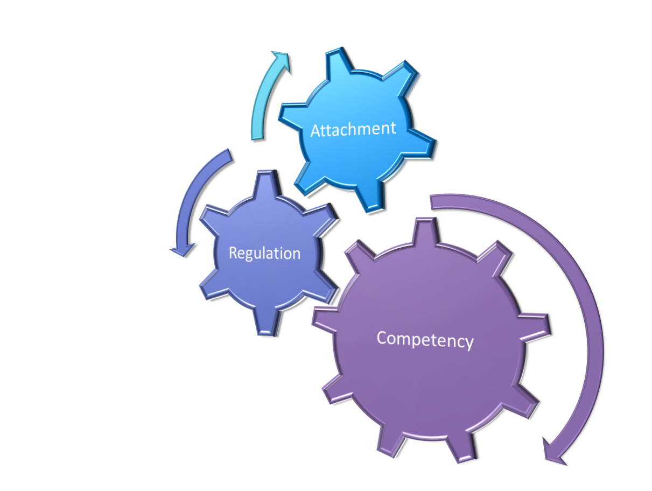
A FRAMEWORK TO HELP
ATTACHMENT
REGULATION (SELF)
COMPETENCY
Notes:
JAY ---- ARC is a framework for intervention with youth and families who have experienced multiple and/or prolonged traumatic stress. ARC identifies three core domains that are frequently impacted among traumatized youth, and which are relevant to future resiliency.

Slide 20
ATTACHMENT:
ATTACHMENT:
TIER 1: ALL Positive relationships between all staff & students (clear expectations help!) Opportunities for clubs, sports & other extracurricular activities Involvement in learning!
TIER 2: SOME Check In/Check Out Check & Connect Small groups formed for particular students Peer Mentoring
TIER 3: FEW Counseling Individual Plans
We can organize our current interventions using the ARC Framework across a Multi-Tiered System of Supports.
Notes:
JOE

Slide 21
REGULATION:
REGULATION:
TIER 1: A few clearly stated expectations with explicit instruction consistently shared among all staff Second Step taught universally to all students Model “how to” for self-regulation adults & peers
TIER 2: Check In/Check Out Check & Connect Small group re-teach ( can use Second Step)
TIER 3: Counseling Individual Plans (FBA/BIP)
We can organize our current interventions using the ARC Framework across a Multi-Tiered System of Supports.
Notes:
JOE

Slide 22
COMPETENCY:
COMPETENCY:
TIER 1: Strong and engaging classroom instruction for all students Differentiated instruction Skill based clubs (strategy games, gardening, cooking!) Music & Art Classes!
TIER 2: Check In/Check Out Small group re-teach ( can use Second Step) After school programs
TIER 3: Counseling Individual Plans (FBA/BIP)
PERSONALIZED LEARNING & INNOVATION
We can organize our current interventions using the ARC Framework across a Multi-Tiered System of Supports.
Notes:
JOE

Slide 23
BUILDING CAPACITY FOR STAFF
Notes:
JOE

Slide 24
BOOK STUDIES & PLC’s HELPED START CONVERSATION:
(Both of these are on your resource handout)
Notes:
JOE

Slide 25
TCI: Therapeutic Crisis Intervention for Schools
A crisis prevention and intervention model that was developed to assist schools in:
Preventing crises from occurring
De-escalating potential crises
Effectively managing acute crises
Reducing potential injury to children and staff
Learning constructive ways to handle stressful situation
** THERE WAS A RELATIONSHIP BETWEEN THE NUMBER OF STAFF TRAINED IN TCI AND THE NUMBER OF OFFICE DISCIPLINARY REFERRALS
Notes:
JAY

Slide 26
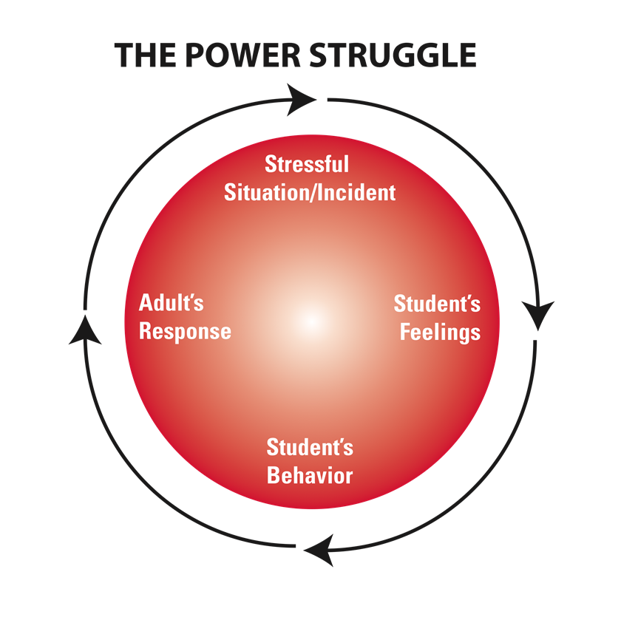
TCI TRAINS STAFF TO AVOID THE CONFLICT CYCLE & UNDERSTAND THE ANTECEDENTS TO STUDENT BEHAVIOR.
BEHAVIORS
FEELINGS
&
NEEDS
STAFF ARE TRAINED TO UNDERSTAND STUDENT BEHAVIOR AS SURFACE EXPRESSIONS OF FEELINGS & NEEDS
Notes:
JAY

Slide 27
YMHFA: RECOGNIZE SIGNS & SYMPTOMS OF MENTAL HEALTH PROBLEMS & HOW TO OFFER HELP BEFORE, DURING AND AFTER A MENTAL HEALTH CRISIS.
We trained over 575 persons through a Project AWARE grant (SAMHSA Funded)
100% of participants recommended this training for others.
Find out more at mentalhealthfirstaid.org
Notes:
JAY

Slide 28
COMPASSION FATIGUE or vicarious trauma:
IMPACT IS SIMILAR TO TRAUMA
-IS JUST AS PERSONAL & UNIQUE
- PHYSICAL, MENTAL & EMOTIONAL IMPACT
- LONELINESS CAN WORSEN IMPACT
- EDUCATORS SHOULD HAVE SELF-CARE PLANS
Notes:
JOE

Slide 29
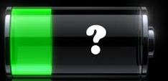
SELF- CARE
HOW DO YOU RECHARGE & HEAL?
WHO IS “THAT PERSON” FOR YOU TO GO TO WHEN YOU NEED HELP?
MENTAL/ PSYCHOLOGICAL | SOCIAL/ BEHAVIORAL | PHYSICAL/ HEALTH
REFLECTION | BOUNDARIES | REST
BOUNDARIES | USE VACATION | NUTRITION
SOLITUDE | PEER SUPPORT | EXERCISE
READING | HUMOR/LAUGH | SUNSHINE
Notes:
JOE

Slide 30
Adapt, not additional
IN SCHOOLS, MUCH OF WHAT IS ALREADY DONE CAN BE Integrated INTO A TRAUMA INFORMED APPROACH!!
DON’T THINK “MORE”– THINK “ADAPT CURRENT PRACTICE”
Notes:
JAY

Slide 31
SMALL Group Activity
Discuss one action step you can take in the near future to make your school/district more responsive to trauma.
Notes:
JAY

Slide 32
Small is the New BIG
School
Classroom
Red Envelope
Kitchen Table
Homework Club
Universal Pass
Self Monitor In Hallway
Interest Survey
“Bucket”
SST Domains Checklist
Map school hot spots
How to play
Student/Staff connection
Tool kits: Social skill, sensory, etc
Restorative practices
Community Board/Observation
Sounds like/Looks like
30 second conversations
Greetings as enter/Welcome back
Multiple Desks
Peace Area
Concern Box
Zentangles
Flower Power
Self regulation: Yoga, sensory, brain gym
Scripted conversation
Lunch
Reframe comments/Requests
Ticket to Do
Inter-grade transition form
“Tool Kits”-Sensory, transitions
Restorative practices
JOEL WILL BE HERE OCT. 18TH!
Notes:
JAY

Slide 33
Thank You!
jfantigrossi@lyonscsd.org
jroscup@lyoncsd.org
@jfantigrossi and @RoscupJay on Twitter
JosephFantigrossi.com
Notes:
JOE

